Slide 1
Bank Management Application
Mohd Irshad
Munit Yadav
Amrita Priyadarshini
Dadapeer Momin

Slide 2
Problem Statement
Bank is the place where customers feel the sense of safety for their property/ money. In the bank the customer deposit and withdraw their money.
Transaction of money is also part where the customer takes shelter of bank. Now to keep the trust of customers, there is the positive need for management of the bank, which can handle all this with comfort and ease.
Smooth and efficient management affects the satisfaction of the customers and staff members, indirectly. In addition, it encourages management committee in taking some needed decision for future enhancement of the bank.

Slide 3
Our Objectives
To reduce the manual works required to be done in the bank.
To avoid errors inherent in the manual work and hence the output consistent and correct.
To make the system menu driven and user friendly. This is necessary so that even non-programmers could use the system effectively and the system could act as catalyst achieving the objective.
To design a system in such a way that reduces the future maintenance and enhancement times and efforts.

Slide 4







Workflow Diagram

Slide 5
Why Spring Boot?
Spring Boot is a project that is built on the top of the Spring Framework.
It provides an easier and faster way to set up, configure, and run both simple and web-based applications.
Spring Boot makes it easy to create stand-alone and RESTful services, production-grade Spring based Applications that you can "just run".
It Offers annotation-based spring boot application.
Eases Dependency management.

Slide 6

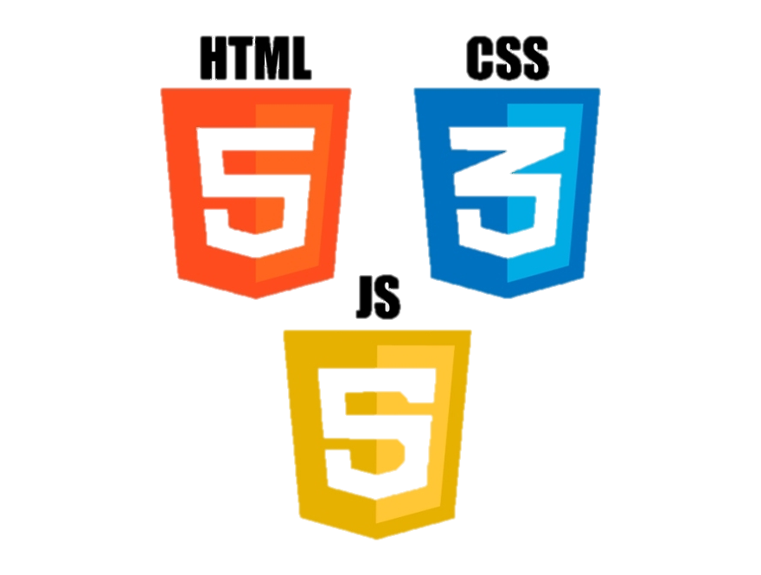

Technology Stack

Slide 7
Dependencies list
<dependency>
<groupId>org.springframework.boot</groupId>
<artifactId>spring-boot-starter-data-jpa</artifactId>
</dependency>
Spring Data JPA
<dependency>
<groupId>org.springframework.boot</groupId>
<artifactId>spring-boot-starter-web</artifactId>
</dependency>
Spring Web

Slide 8
Dependencies list
<dependency>
<groupId>mysql</groupId>
<artifactId>mysql-connector-java</artifactId>
<scope>runtime</scope>
</dependency>
MySQL Connector
<dependency>
<groupId>io.springfox</groupId>
<artifactId>springfox-swagger2</artifactId>
</dependency>
<dependency>
<groupId>io.springfox</groupId>
<artifactId>springfox-swagger-ui</artifactId>
</dependency>
Swagger Documentation

Slide 9
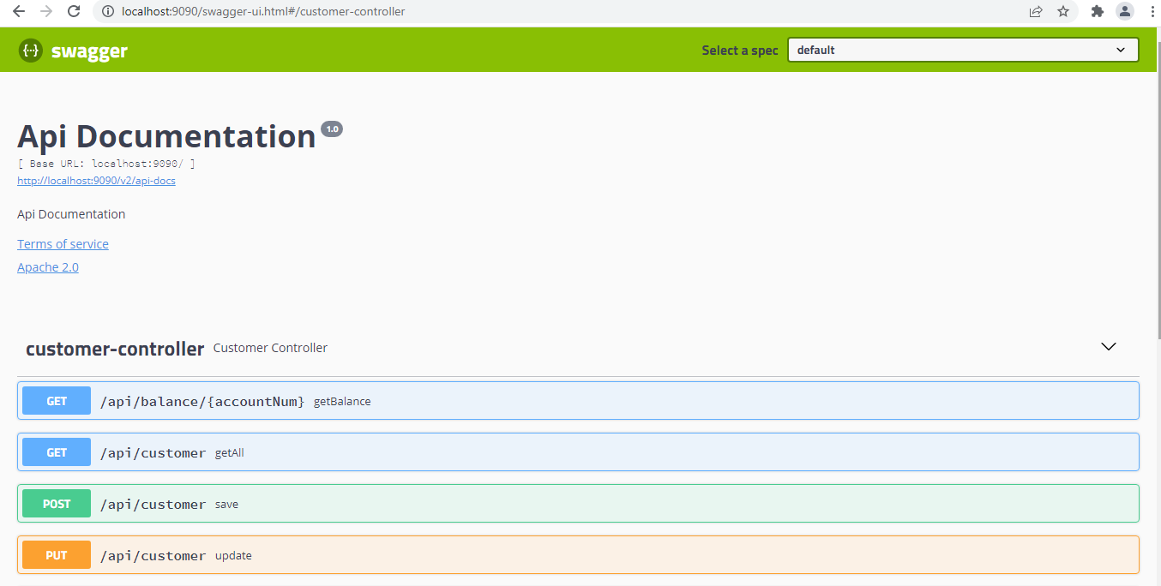
Swagger Documentation

Slide 10
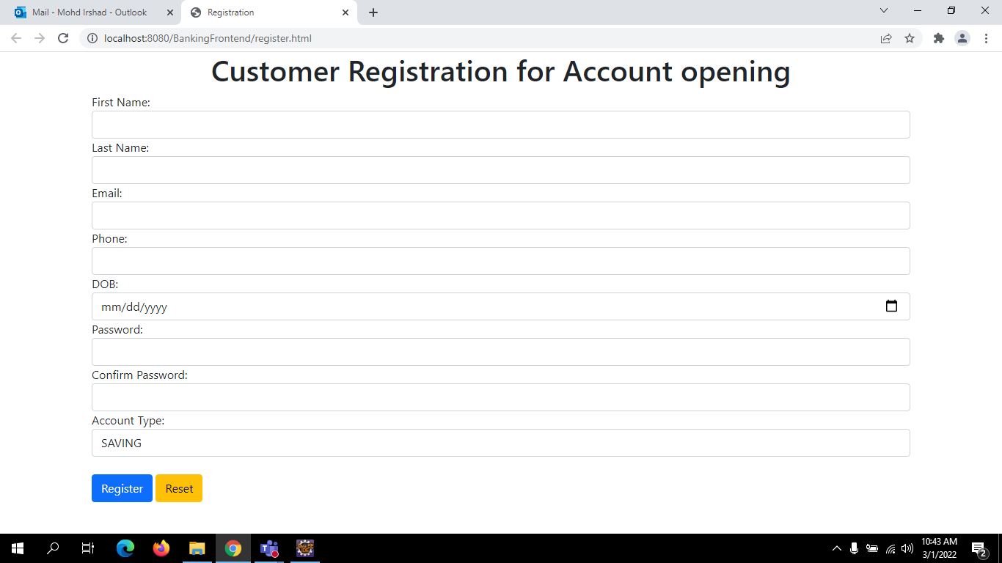
Registration Page

Slide 11
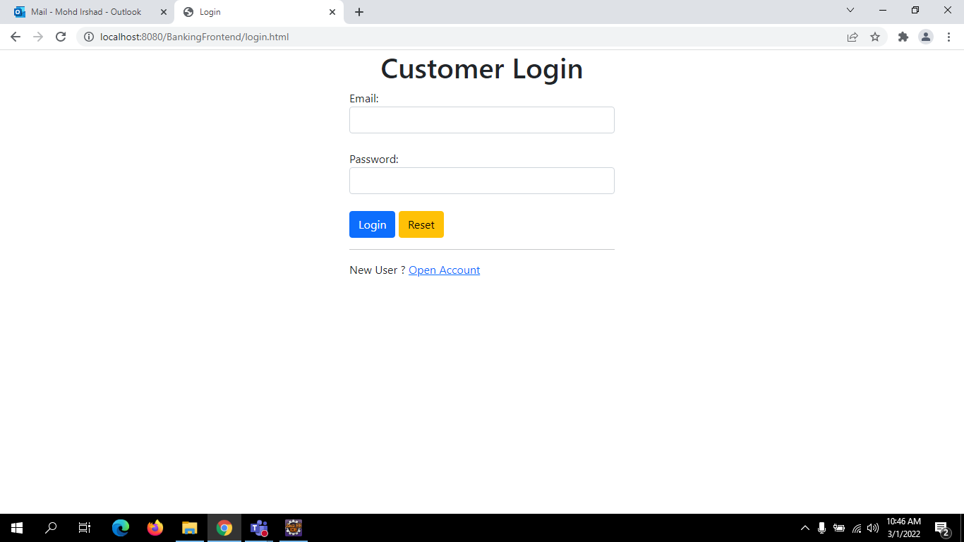
Login Page

Slide 12
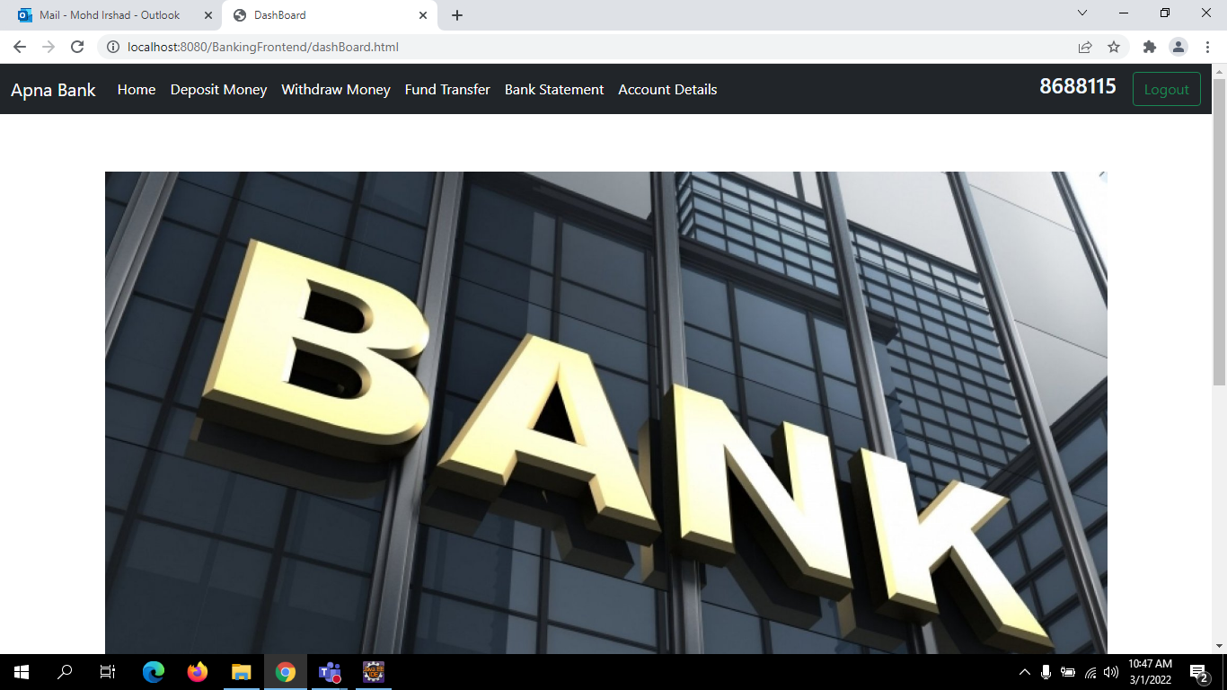
Home Page

Slide 13
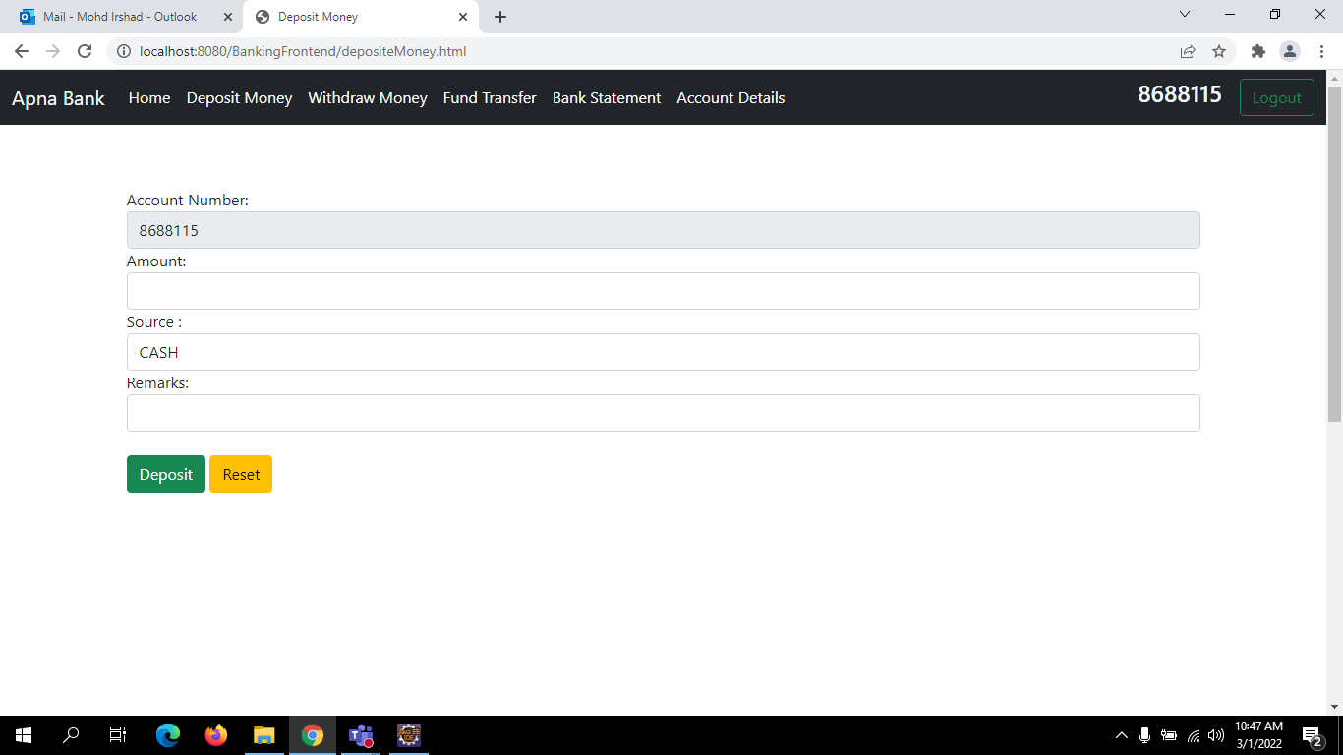
Deposit Money Page

Slide 14
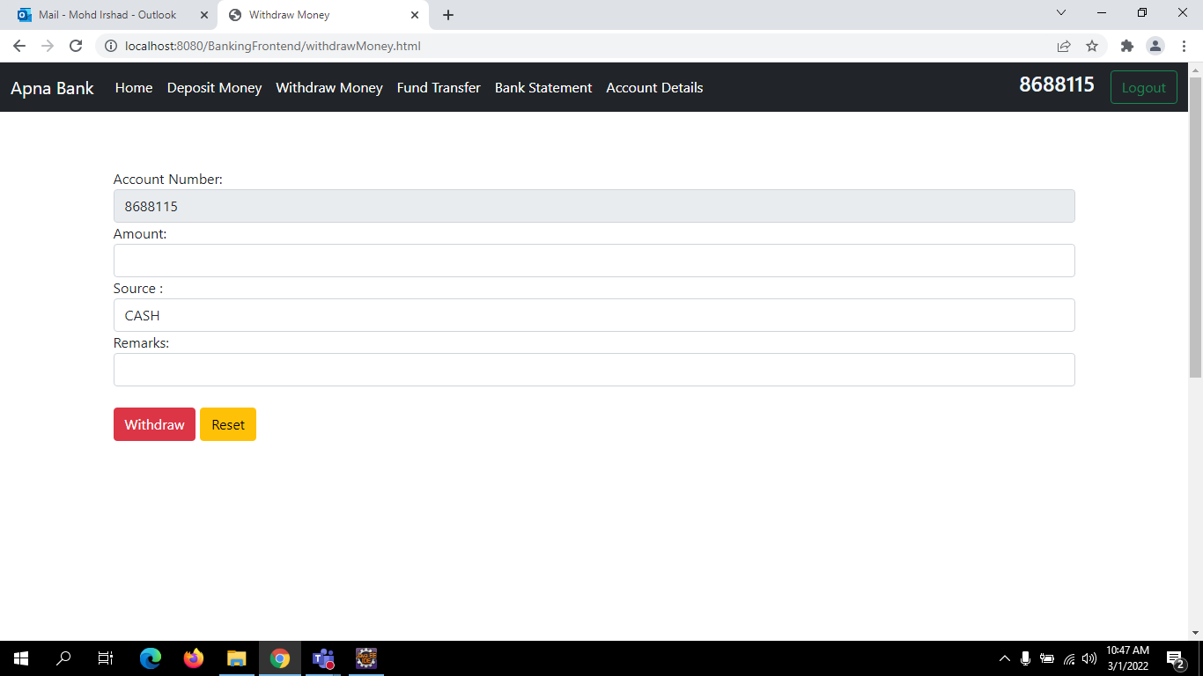
Withdraw Money Page

Slide 15
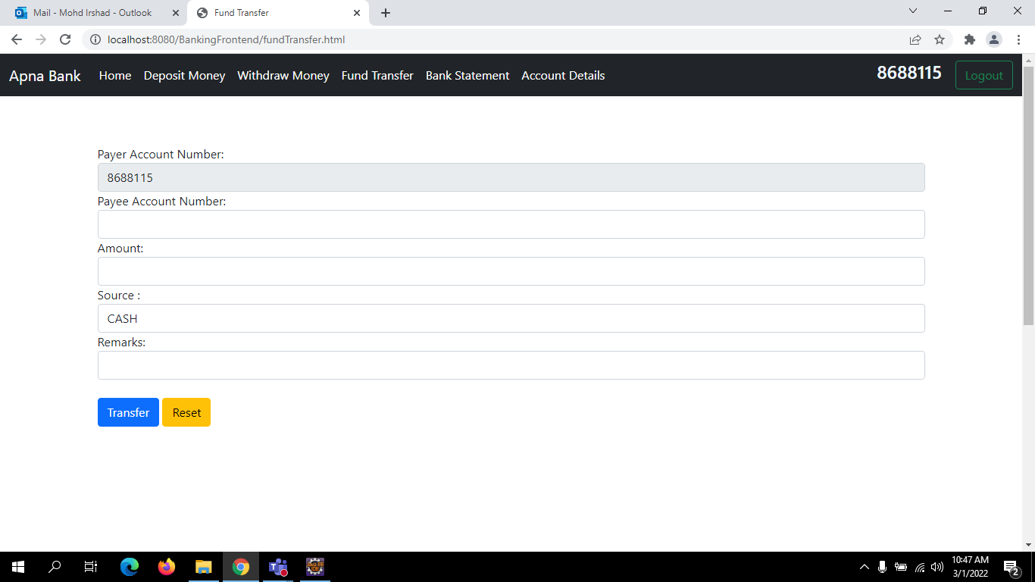
Fund Transfer Page

Slide 16
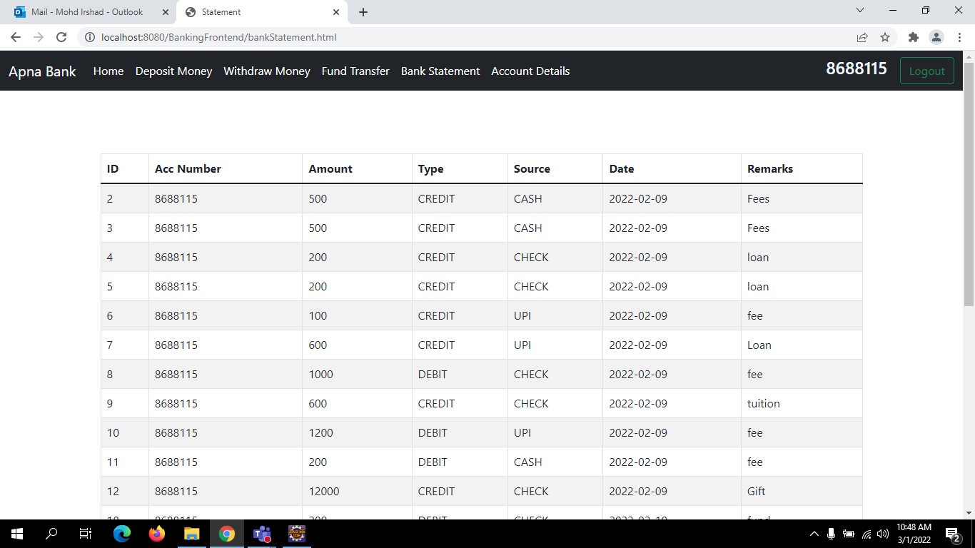
Bank Statement Page

Slide 17
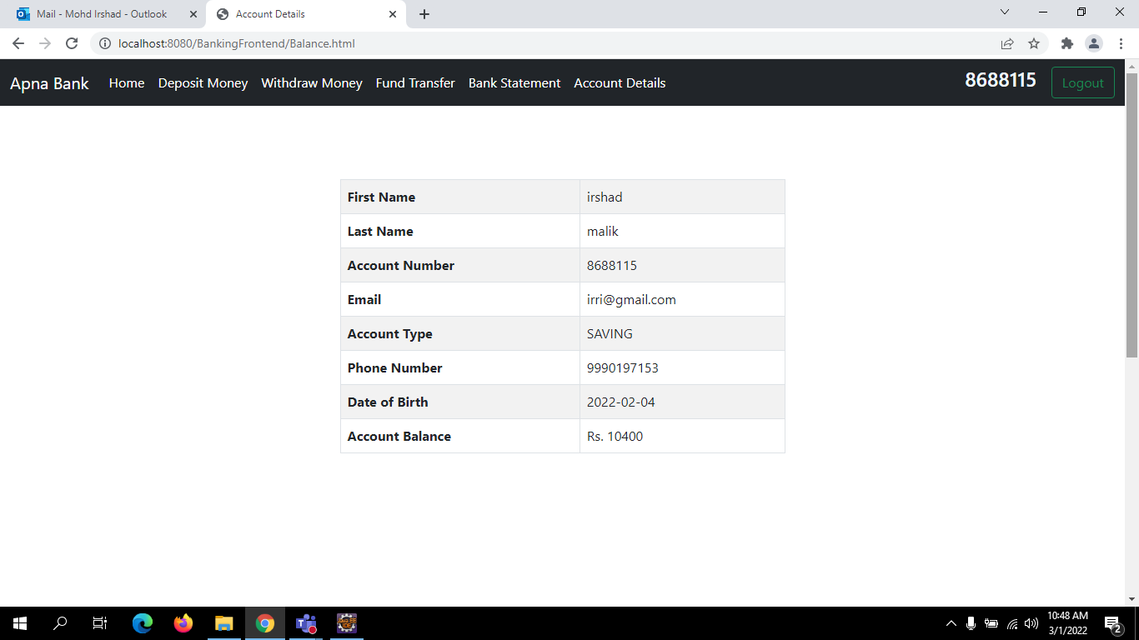
Profile Details Page

Slide 18
Thank You

